Slide 1
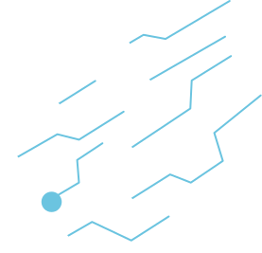

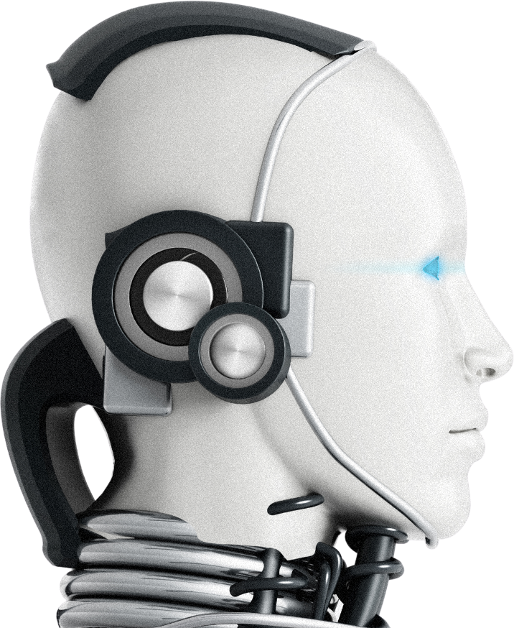

Blochchain Technologies
The Future is Now : Exploring Blockchain
DRIVING INNOVATION, SHAPING THE WORLD

Slide 2
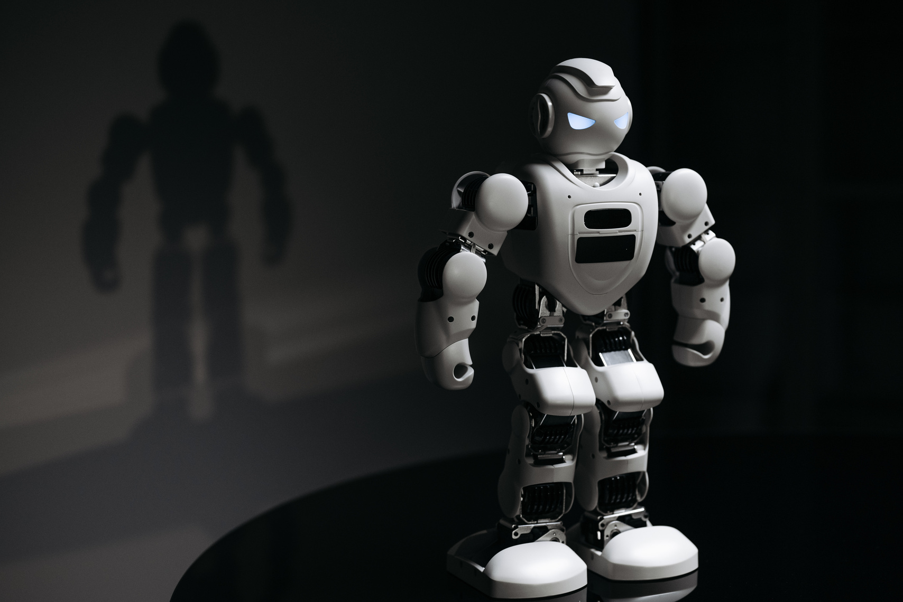

Blockchain and Cryptocurrency

Slide 3
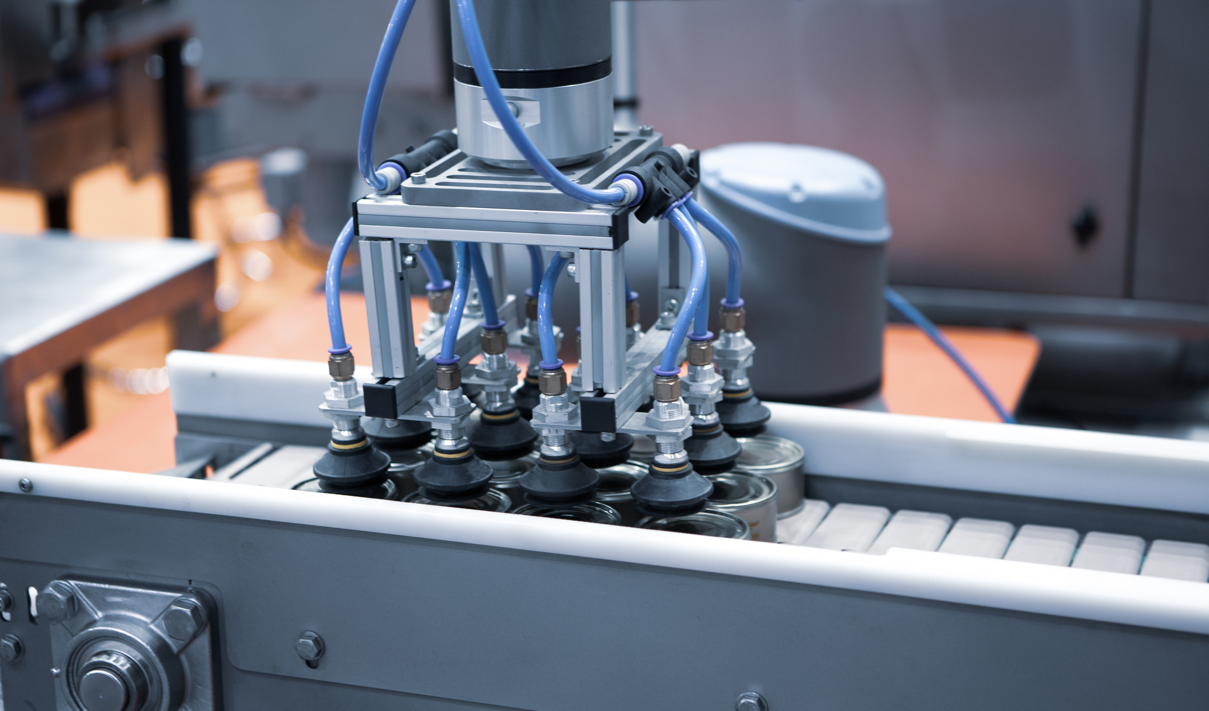
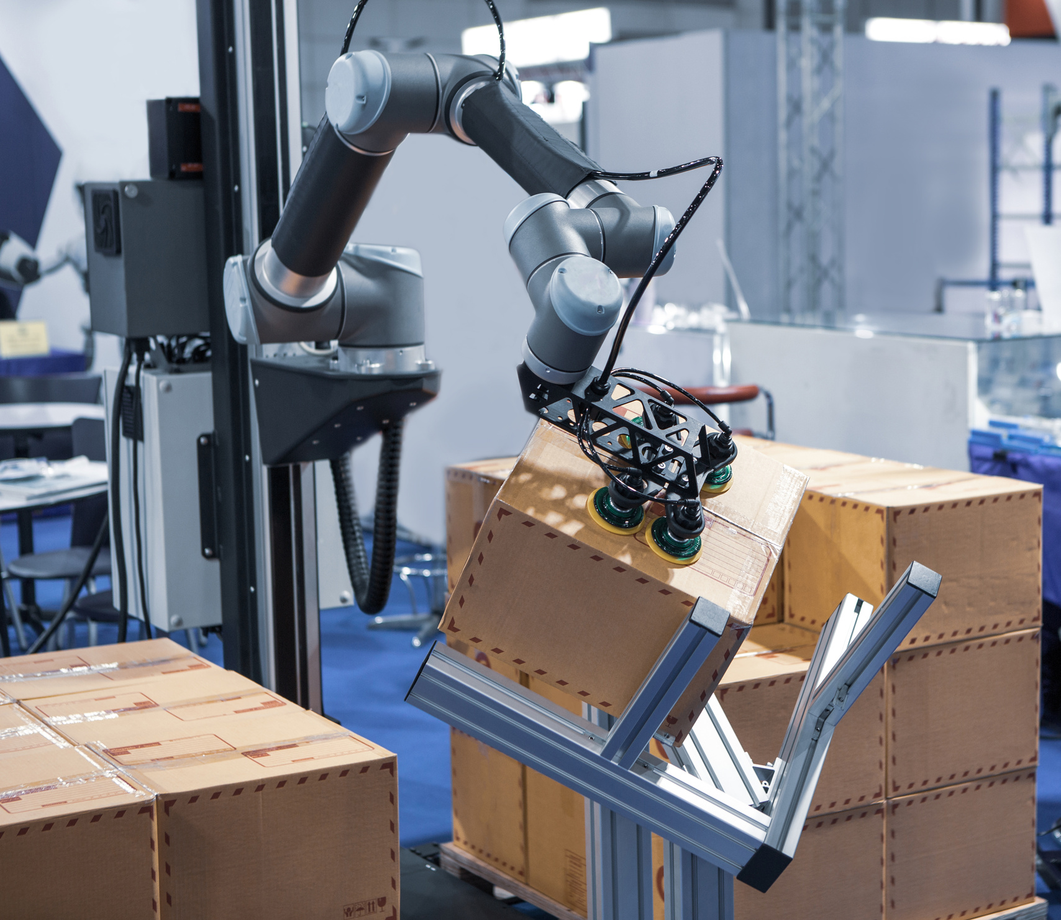
Blockchain Technologies
What is Blockchain Technology?
Blockchain is a decentralized, digital ledger that records transactions securely, transparently, and immutably across a distributed network of computers. It enables trustless transactions without the need for intermediaries (like banks or governments).

Slide 4
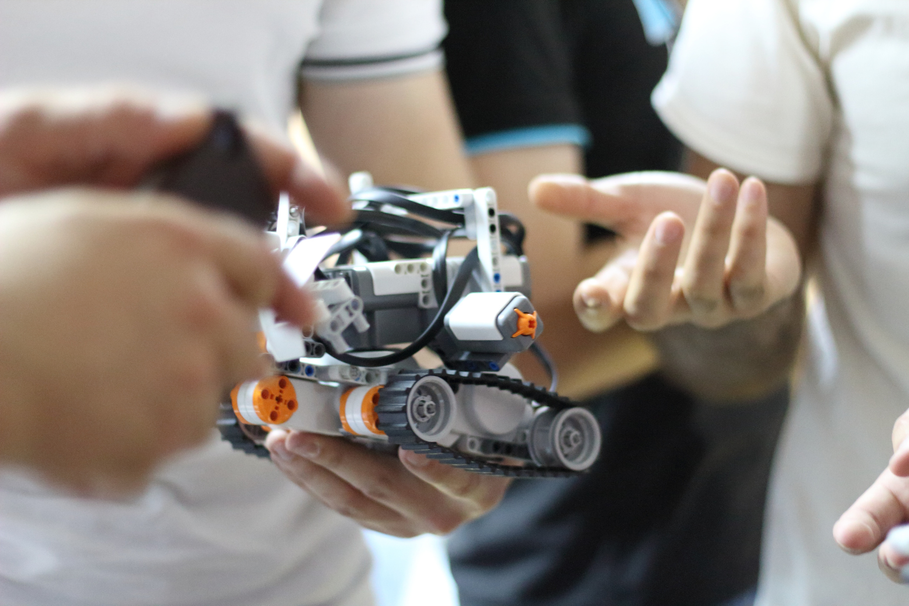
TOKEN SWAP
USER APPROVAL(IF REQUIRED)
If swapping ERC-20 for another ERC-20, user must approve the smart contract to spend their tokens.
ETH swaps don’t require pre-approval as ETH is sent directly.
Initiate the Swap.
The user calls the swap function on a smart contract or DEX (e.g., Uniswap).
They specify the token pair and the amount to swap.
Price Calculation & Validation.
The contract calculates the amount of tokens to exchange based on:
Fixed rate (e.g., 1 ETH = 100 Tokens)
Dynamic rate (via liquidity pools like Uniswap)
It checks if there are sufficient tokens in the contract for the swap.
Execute the Swap
ETH is transferred to the contract, and ERC-20 tokens are sent to the user.
For ERC-20 to ERC-20 swaps, the contract transfers both tokens between parties.
Transaction Confirmation
The swap is confirmed on the blockchain.
Users can track their transaction via Etherscan or in their MetaMask wallet.

Slide 5
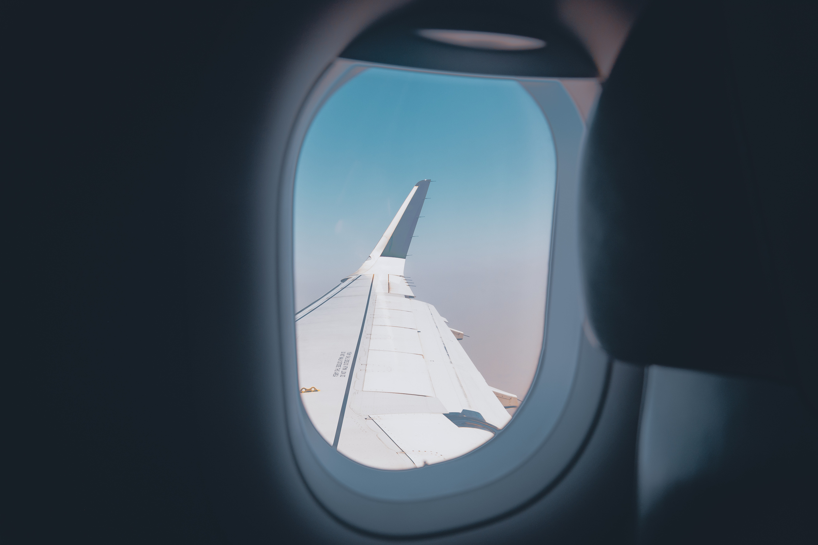
Flight Insurance
User Buys Insurance
A traveler purchases a flight insurance policy using a blockchain-based platform.
Payment is made in crypto (ETH, USDC, etc.) or fiat via a connected wallet (e.g., MetaMask).
The policy details (flight number, date, delay criteria) are stored on a smart contract.
Smart Contract Monitors Flight Data
The smart contract connects to real-time flight data APIs (e.g., FlightAware, Chainlink Oracles).
It tracks whether the flight departs on time, is delayed, or gets canceled.
Automated Payout Trigger
If the flight meets the delay/cancellation conditions, the smart contract automatically releases the payout to the insured wallet.
No need for manual claims or paperwork.
Immutable & Transparent Records
Every transaction is recorded on the blockchain for auditable and tamper-proof claims.
Smart contracts eliminate fraud by ensuring only valid claims get processed.
Decentralized & Cost-Efficient
Removes middlemen (insurance agents, claim processors).
Faster, cheaper, and fair compared to traditional insurance models.

Slide 6
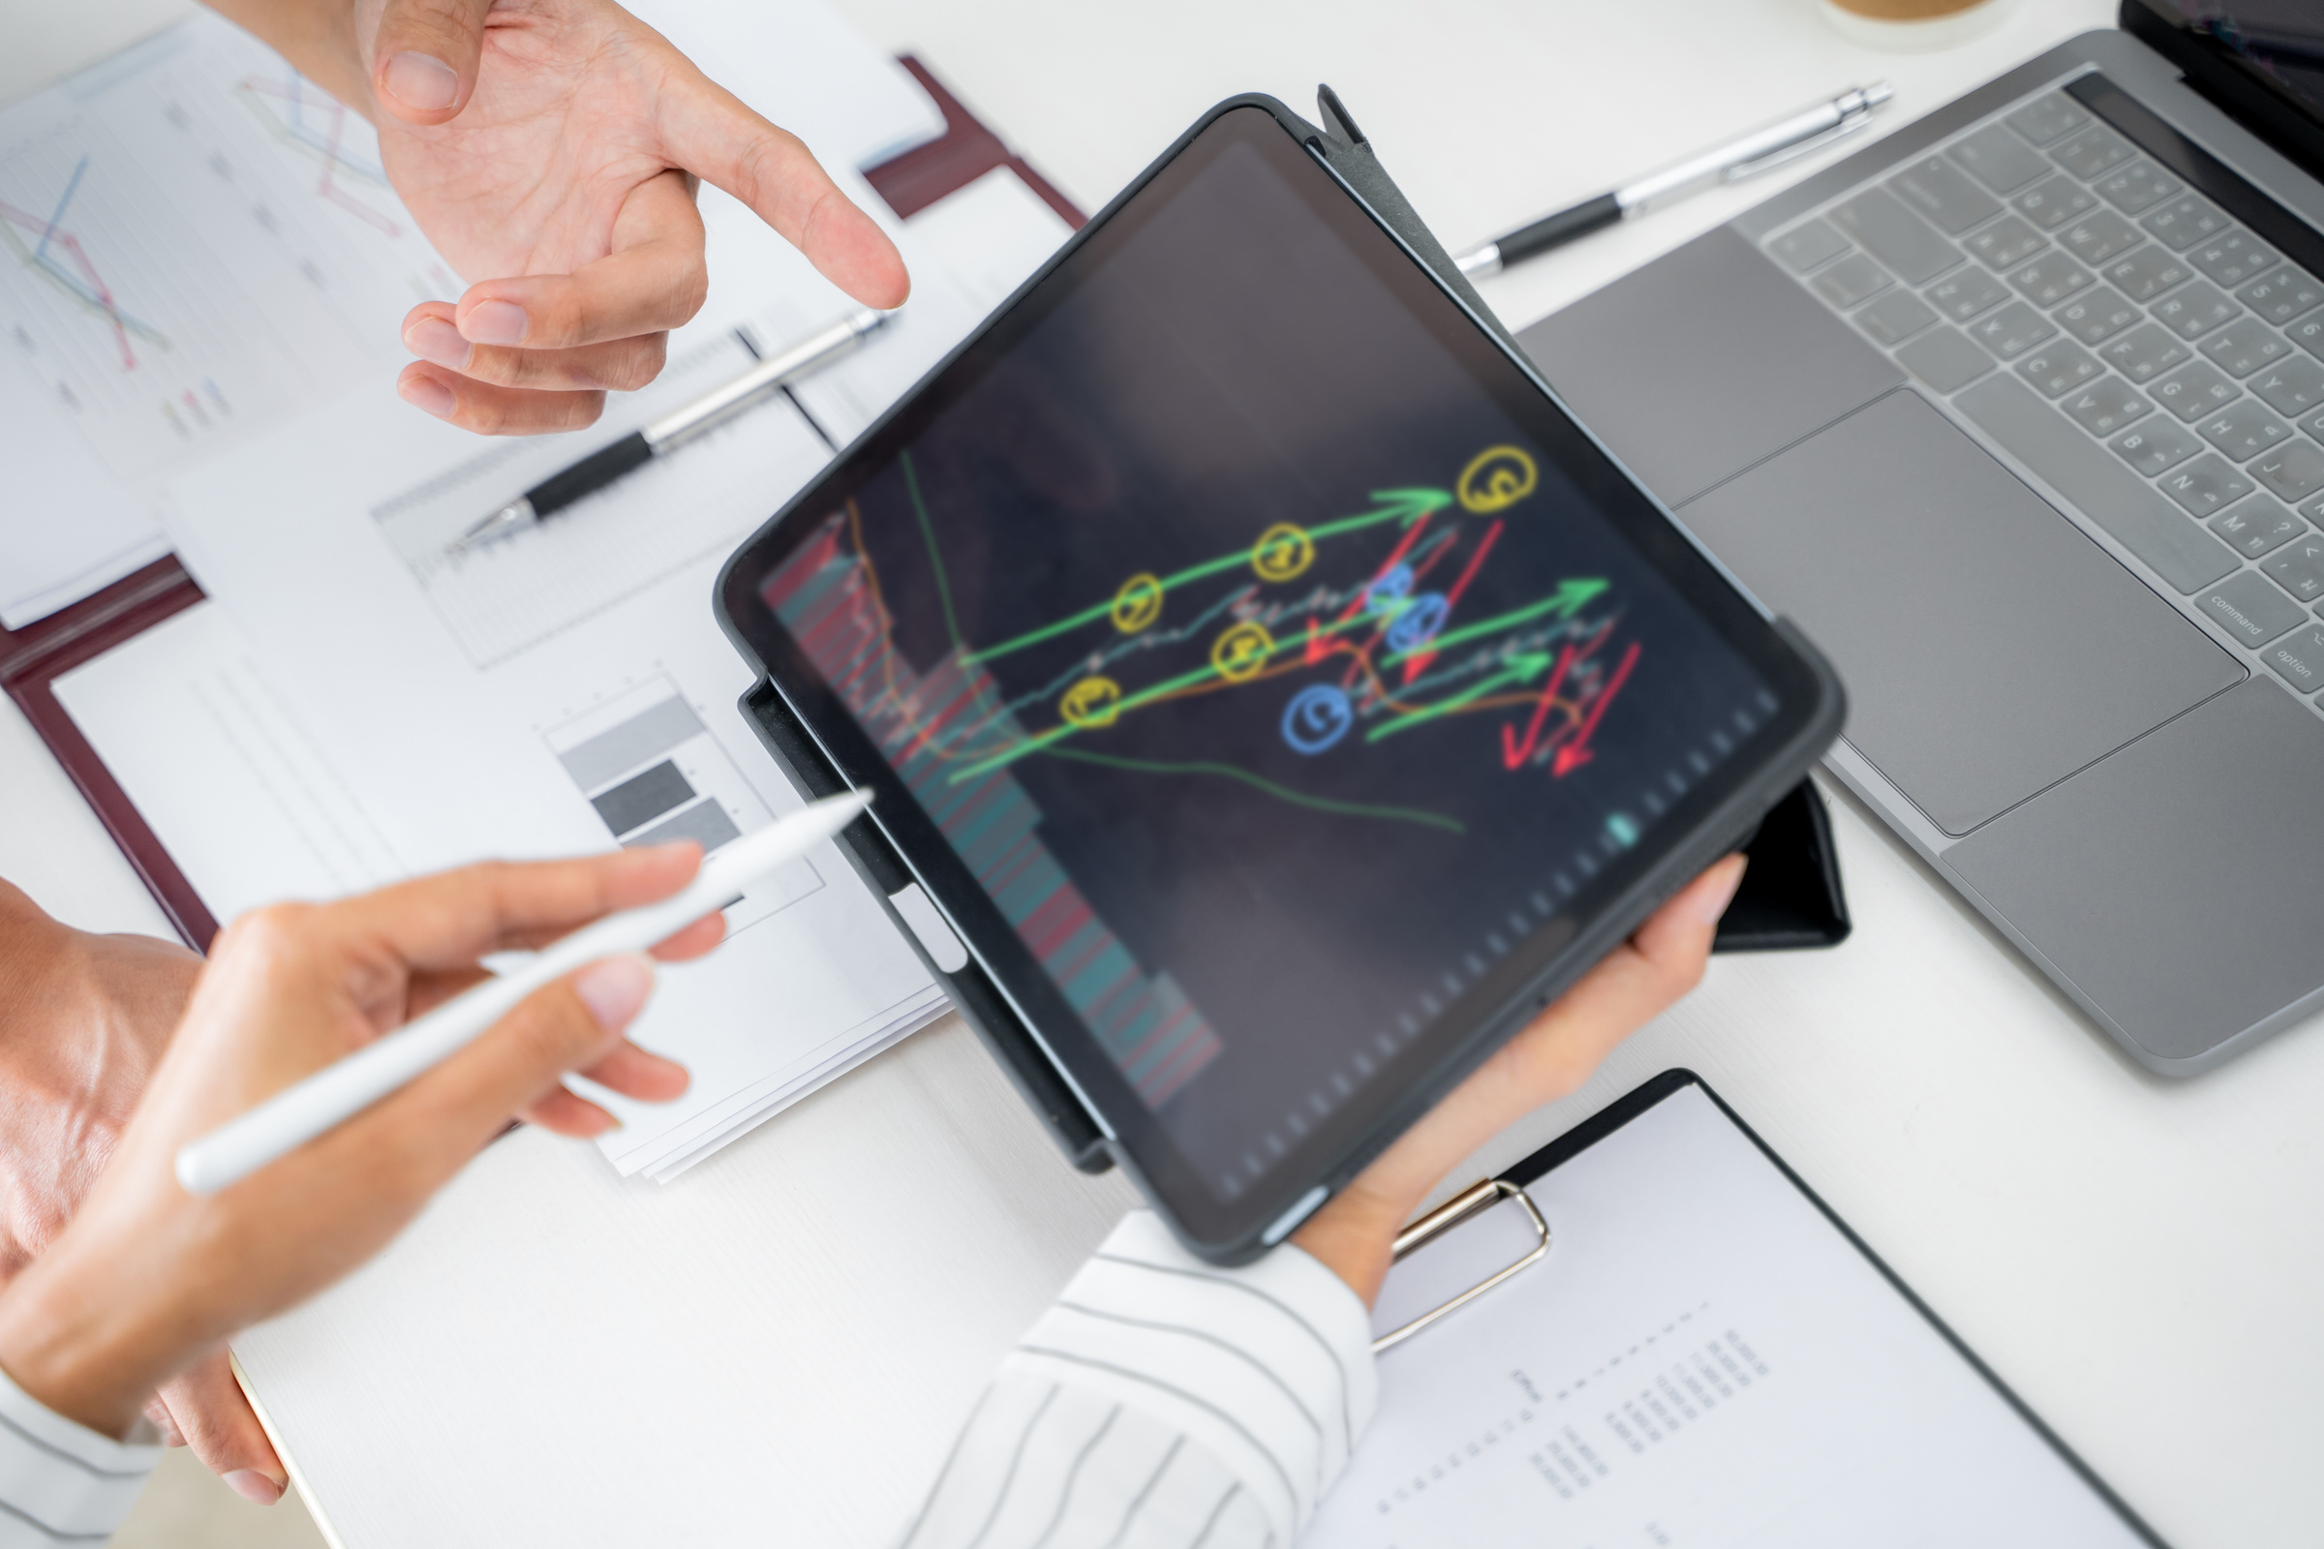
Shopping App
Key Features of a Blockchain Shopping App
Decentralized Marketplace – Buyers and sellers interact directly without intermediaries.
Crypto Payments – Accepts ETH, USDC, BTC, or stablecoins for transactions.
Smart Contracts – Automates order processing, refunds, and dispute resolution.
NFT Receipts & Ownership – Purchases are recorded as NFTs for verifiable proof of ownership.
Loyalty Rewards & Tokenization – Customers earn blockchain-based reward tokens.
Supply Chain Transparency – Blockchain stores product history for authenticity verification.

Slide 7

HOTEL REGISTRATION
EMPOWERING SMARTER SOLUTIONS
Smart Contracts for Reservations – Automates booking, payments, and refunds.
NFT-Based Room Ownership – Guests receive NFTs as proof of reservation.
Crypto Payments – Accepts ETH, USDC, BNB, or stablecoins for bookings.
Decentralized Identity (DID) – Guests use blockchain-based digital IDs.
Loyalty & Reward Tokens – Hotels issue tokenized loyalty points.
Supply Chain Transparency – Tracks hotel services (laundry, F&B) on-chain.

Slide 8
Blockchain for Voting
REVOLUTIONIZING TRANSACTIONS
Decentralization – No central authority controls the voting; it's managed by the Ethereum blockchain.
Immutable Voting Records – Once a vote is cast, it cannot be changed or deleted.
Transparent & Verifiable – Anyone can verify votes on the blockchain.
Secure & Fraud-Proof – Prevents double voting or vote manipulation.

Slide 9
STELLAR

Slide 10
BLOCKCHAIN TOKENS
DIFFERENT TOKENS OF BLOCKCHAIN

Slide 11
www.reallygreatsite.com
CONCLUSION
Let’s Shape the Future Together

Slide 12
Thank You
For Attention
DRIVING INNOVATION, SHAPING THE WORLD
See You Next Time

